Slide 1
HR ATTRITION ANALYSIS
BY
AARTHI KRISHNAN

Slide 2
OBJECTIVE
The purpose of this report is to analyze employee attrition patterns within the organization using Power BI. Attrition insights help HR teams understand trends, identify high-risk departments, and implement proactive strategies to retain talent and reduce turnover.

Slide 3
KEY METRICS ANALYZED
ATTRITION RATE
EDUCATION LEVEL & JOB ROLE IMPACT
ATTRITION BY BUSINESS TRAVEL
ENVIRONMENT SATISFACTION & JOB SATISFACTION IMPACT
WORK LIFE BALANCE IMPACT ON ATTRITION RATE
OVERTIME IMPACT

Slide 4
INSIGHTS
Attrition Percentage from overall employee is 16 %
Attrition Range around 25-34 age group has the maximum attrition count.
Over Time can also be one of the reason for attrition as the attrition count for Over Time is more.
Employee with Bachelor’s Degree has the more Attrition count
It is also important to note that Employee with highest job level has the highest attrition count.

Slide 5
Employee getting highest Salary Hike tends to stay within the company.
R&D Department has the maximum Attrition count in which Laboratory Technician has more attrition count
It is important to notice that the employee who travel rarely has the highest attrition rate around 66% than employee travelling frequently.
Employee having Good Work Life Balance(rating - 3) also has the highest attrition count than the rating given for 1.
Employee with 3 Job Satisfaction rating has the more attrition count.

Slide 6
CONCLUSION
This HR attrition report provides a data-driven approach to understanding why employees leave and where interventions are needed. The insights empower HR professionals to make informed decisions, reduce turnover, and foster a more satisfied and productive workforce.

Slide 7
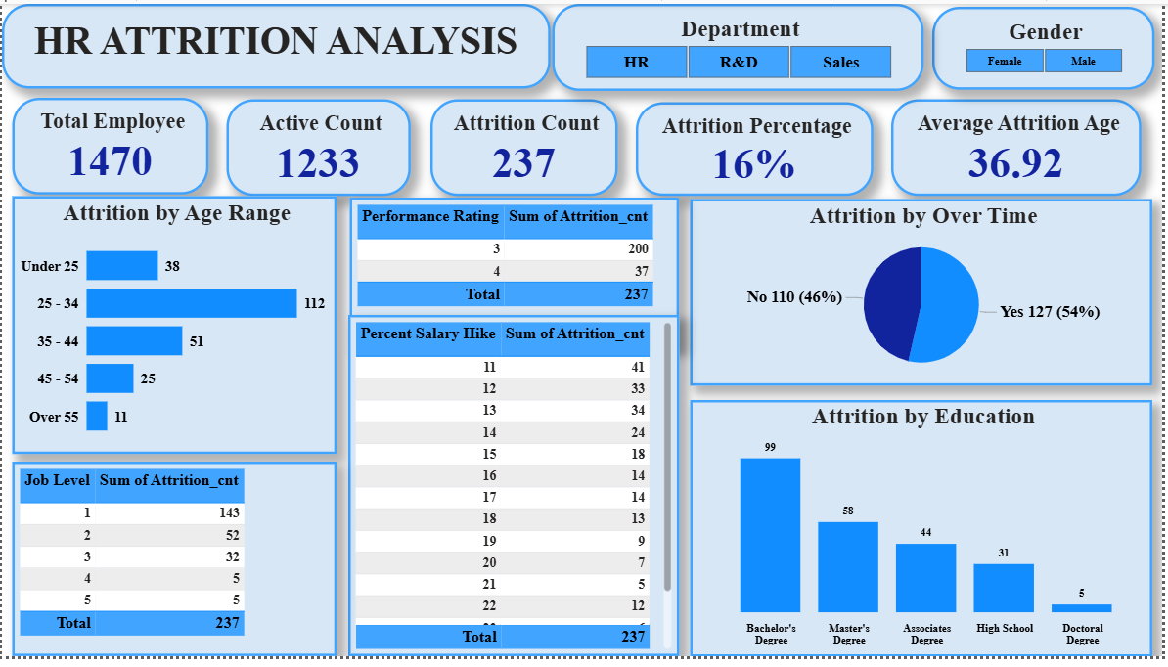

Slide 8
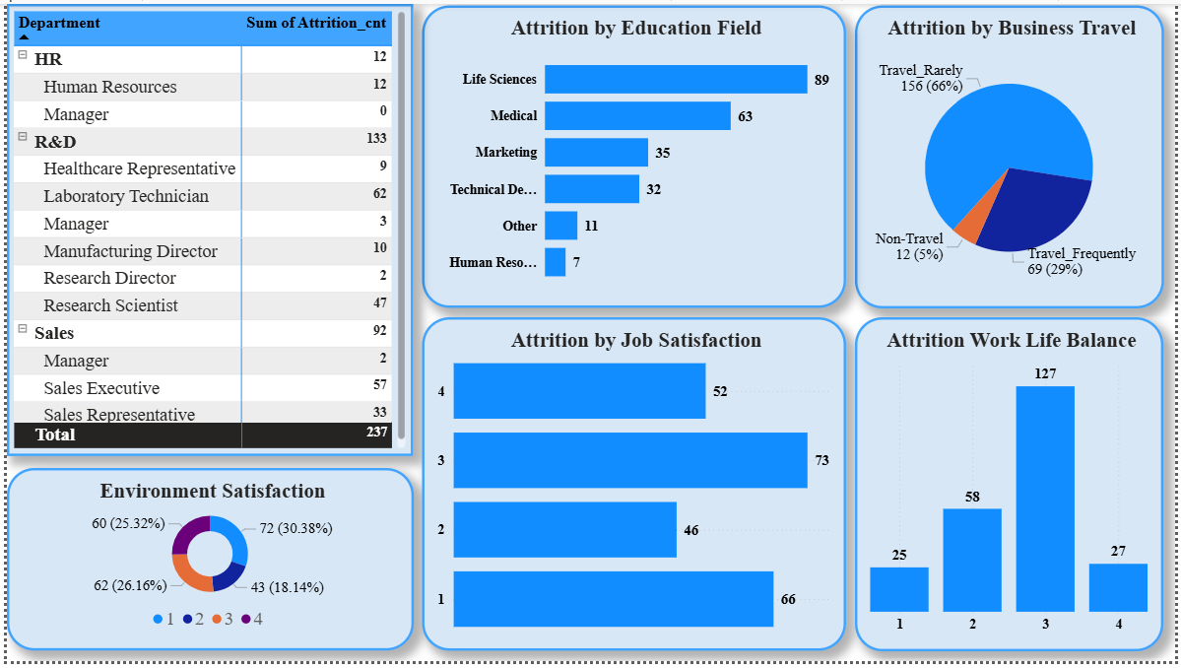

Slide 9
THANK
YOU

